Slide 1

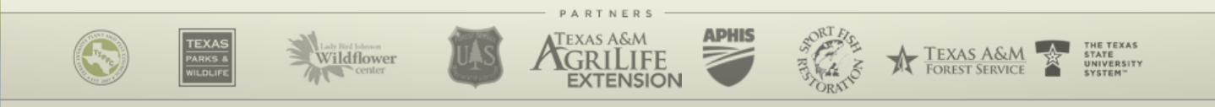
Take Action
USDA-APHIS
Texas Invasive Species Institute (TISI)
SHSU Agriculture Sciences
SHSU Engineering Technology

Slide 2
TEKS / OBJECTIVES
TEKS: 130.25 1 (A-E) 4 (A-E) The student demonstrates professional standards/employability skills as required by business and industry. The student uses critical thinking, scientific reasoning, and problem solving to make informed decisions within and outside the classroom.
Objectives:
The student will discover new career opportunities in the biosecurity field of agriculture.
The student will construct a plan to Take Action! on invasive species and agriculture biosecurity.

Slide 3
Warm-Up Question
Pick your favorite pest that we have talked about the past few days. How does that pest spread?

Slide 4
Thinking Questions
What makes this species invasive rather than non-native?
How do human actions contribute to the spread of invasive species?
How does this species affect the balance of its new ecosystem?
What specific traits allow this species to thrive in a non-native environment?

Slide 5
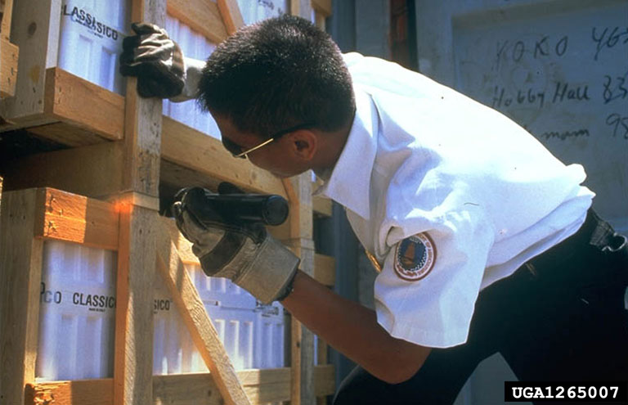

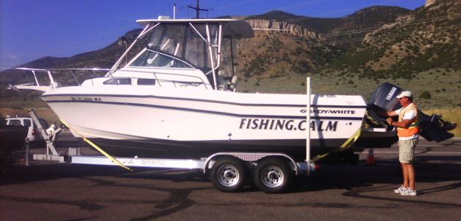
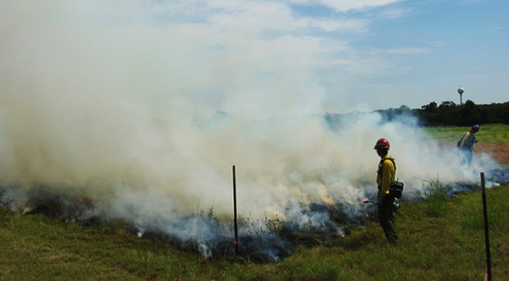
Action Response to Invasive Species
Regulation
Import/export restrictions (USDA-APHIS)
Inspections and surveillance
Research
Species biology/ecology
Ecological impacts
Biological controls
Habitat Restoration
Control and Management
Monitoring
Restoration
This is where you can help!
Notes:
The best method for combatting the effects of invasive species is to prevent their initial introduction.
Regulation, including import restrictions, inspections and prohibited lists work to stop movement and introduction of invasive species. The USDA APHIS is primarily tasked with preventing introductions to the nation, in which it prevents entry and establishment through intrastate and international trade.

Slide 6


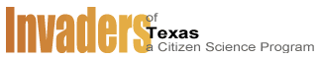
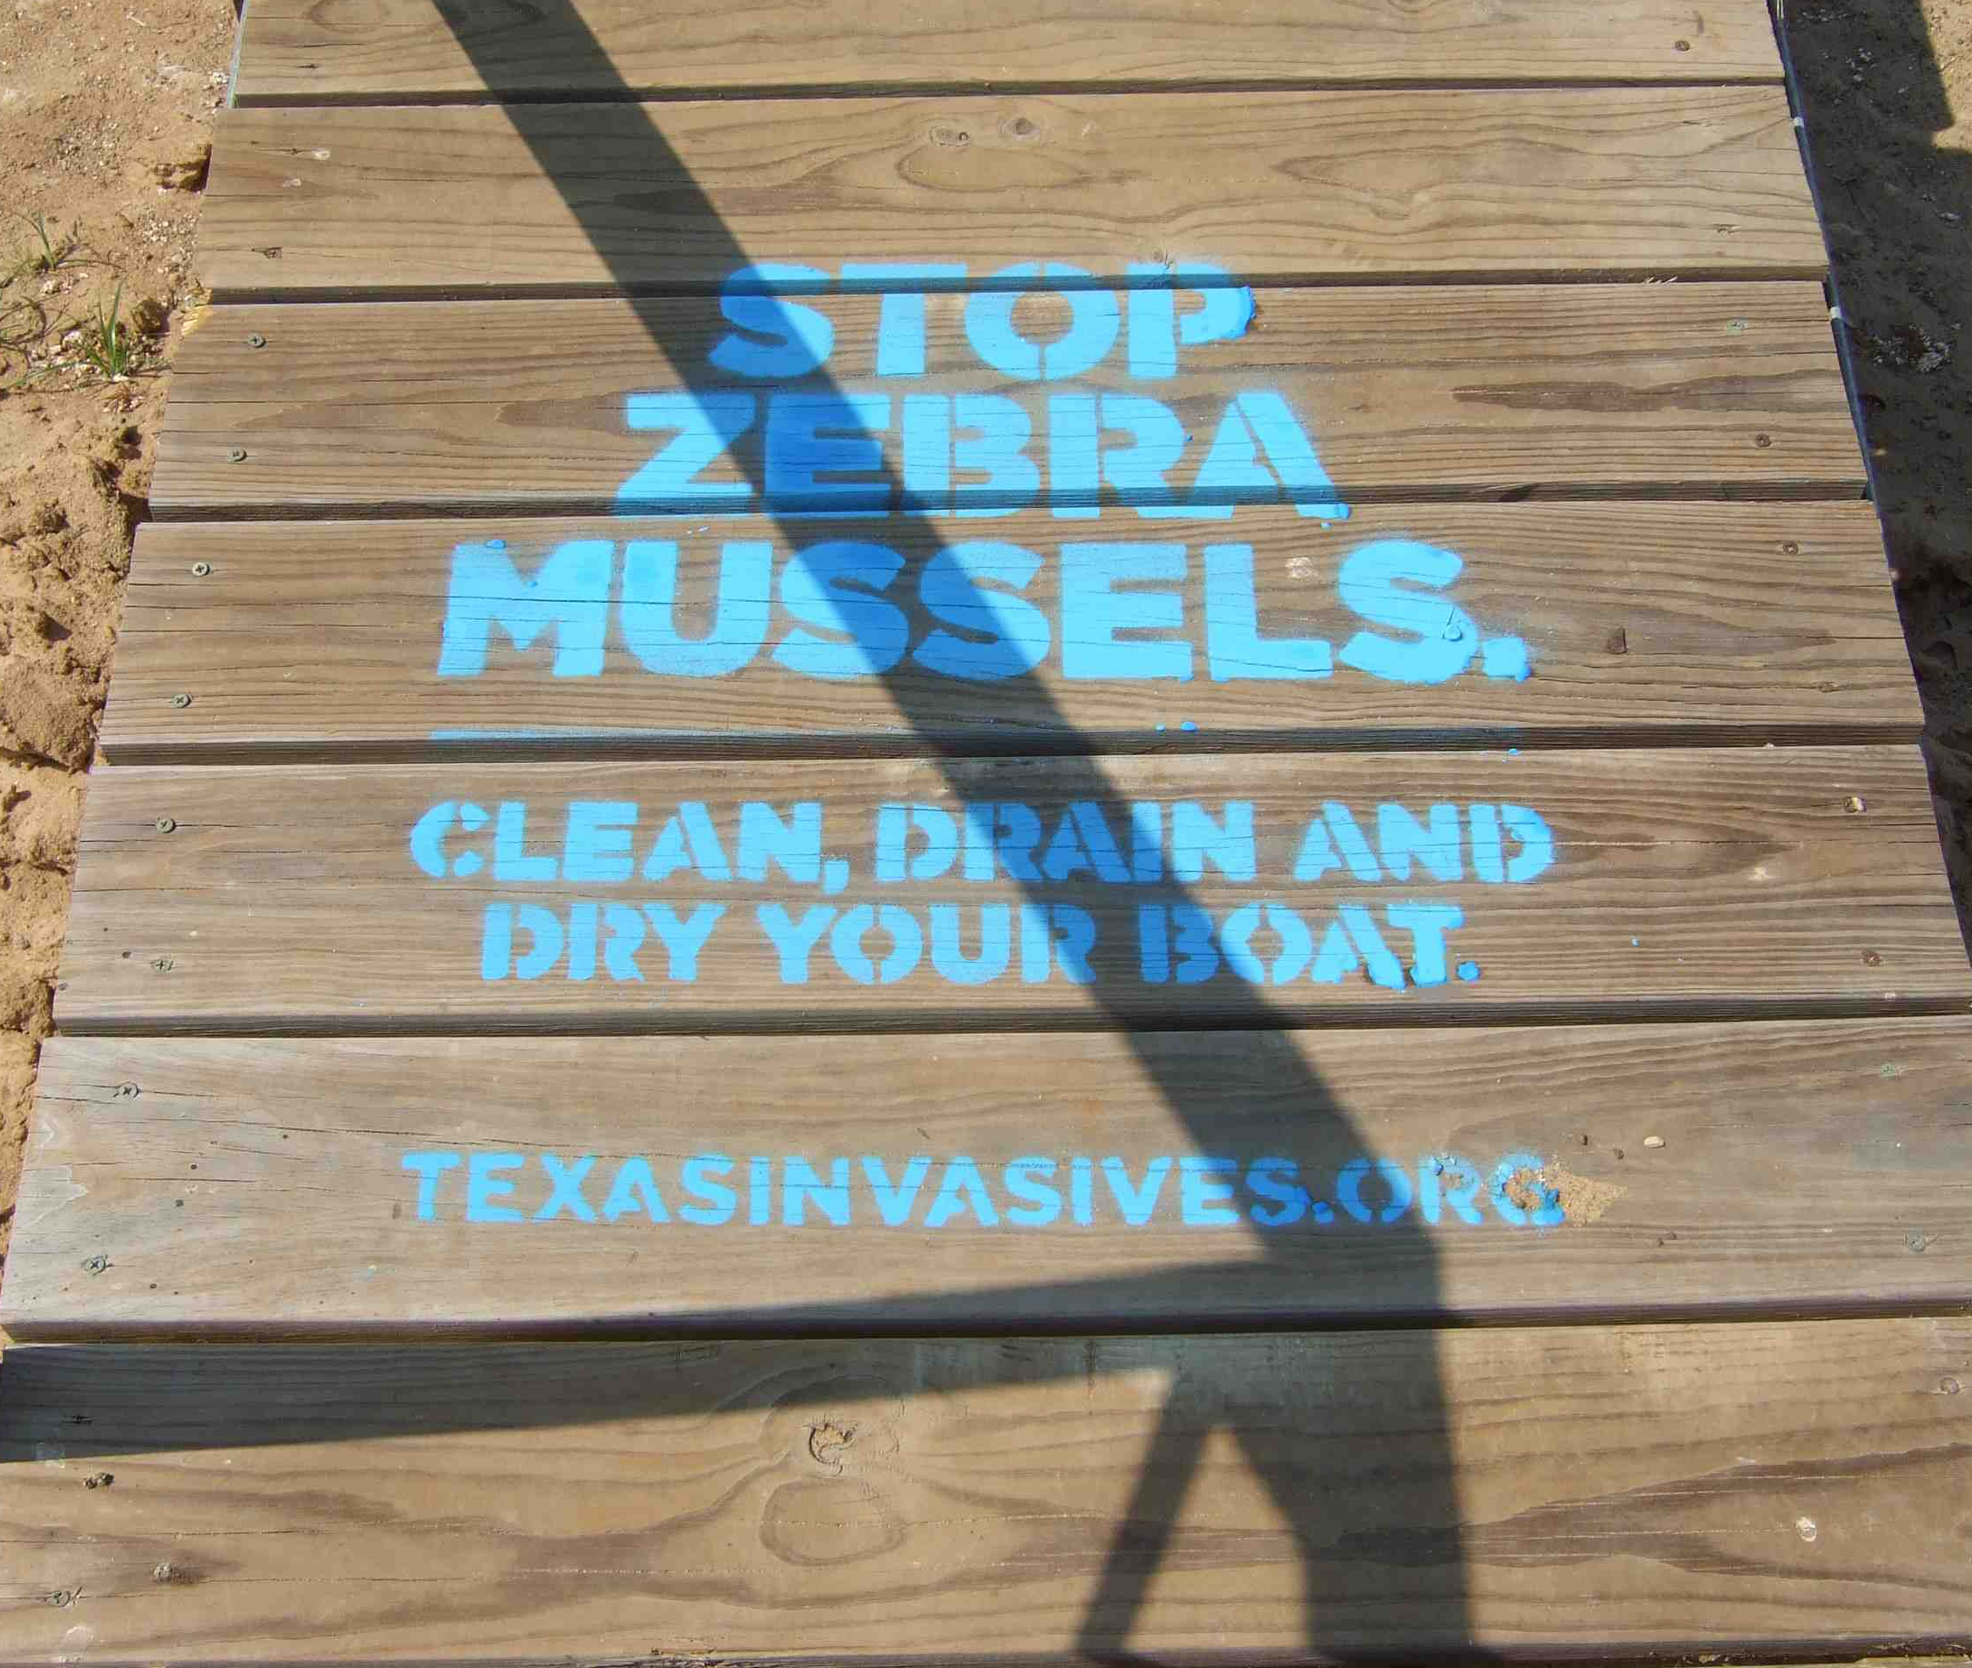


Outreach & Public Awareness Response to Invasive Species
Early detection trainings
Native Plant Diagnostic Network
EDRR Local (Washington State)
AG BIOSECURITY CURRICULUM
Invaders of Texas
Through texasinvasives.org
You’re eligible to register at the end!
Public Awareness campaigns
CLEAN, DRAIN, DRY!
Don’t Move Firewood
Never Dump Your Aquarium
Transport Zero
Play, Clean, Go
Notes:
Public awareness of invasive species and the damage they can cause is key to successful action.

Slide 7
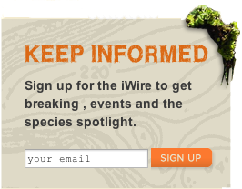
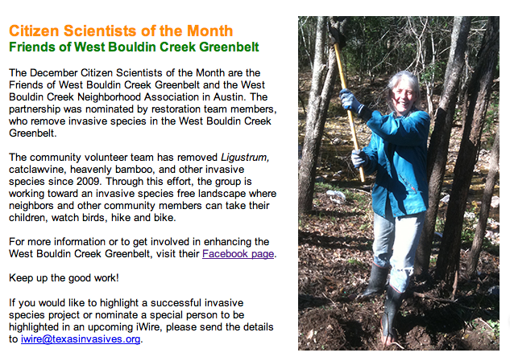
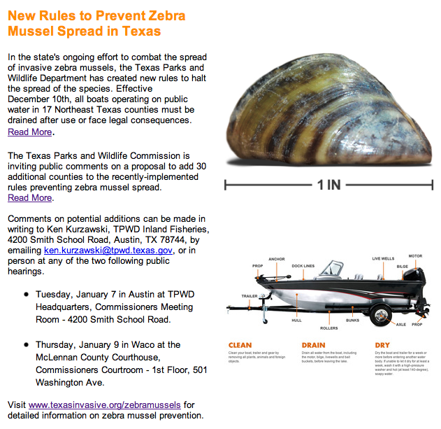
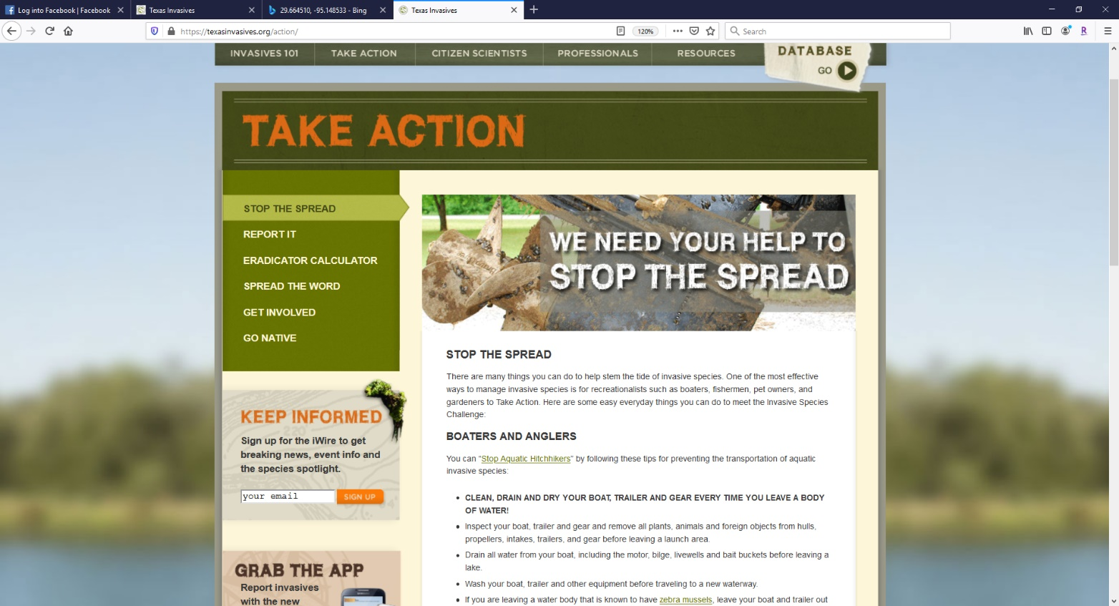
Stay informed with Texasinvasives.org
iWire monthly email newsletter
Important updates on invasives
News from TX and beyond
Citizen Scientist spotlights
Sign-up at texasinvasives.org
Take Action! Tab
Keep Informed
Notes:
We also publish a monthly email newsletter, the iWire, which contains species alerts, information on upcoming events and news features.

Slide 8
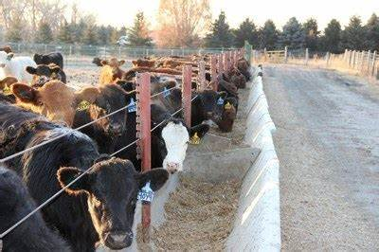
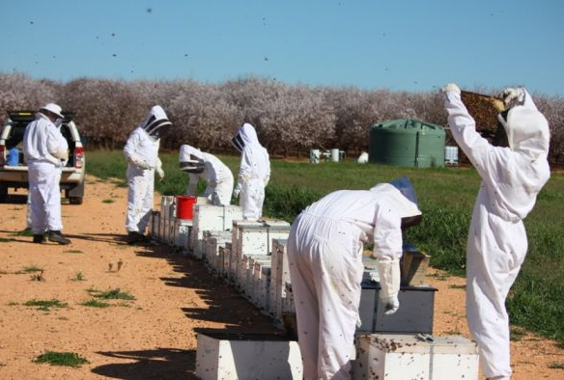
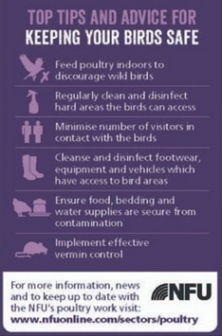
Careers in Ag. Biosecurity
Agricultural Biosecurity Careers
Biosecurity Monitor
Animal Farm Technician
Oversee biosecurity protocols to keep animals healthy for production.
Production & Livestock Manager
Field Inspection Coordinator
Farm Auditor
Ensuring farms are using Biosecurity protocols for animal success.
Agexplorer.ffa.org
Agcareers.com
Seedyourfuture.org

Slide 9








Careers in Invasive Species Management
Customs (USDA/APHIS)
State Department of Agriculture
Includes Texas Department of Agriculture
Texas Parks and Wildlife
Invasive Species Biologist
Bio-control developer
National Institute of Food & Agriculture (NIFA)
Food and Agriculture Defense Initiative
Crop Protection & Pest Management Program
US Forest Service
ALL state Forestry entities
Includes Texas A&M Forest Service
National Parks System
City Park Manager Programs
US Fish & Wildlife Service
Wildlife Refuge Areas

Slide 10
Take Action!
Preventing Invasive Species
& How to Report Sightings
Notes:
Next we’ll discuss how YOU can help prevent the spread of invasives.

Slide 11
Partner Activity:
Choose a pest that we have covered in this unit and make a brochure!- List, draw, and describe characteristics of the pest on the front cover.
Brochure Requirements: h
Strategies for the prevention of the spread
Insecticides or Herbicides that can be used to stop the spread
Signs of damage in plants
Include at least three illustrations in the brochure.
What agencies to contact
What agricultural crop does this affect?

Slide 12
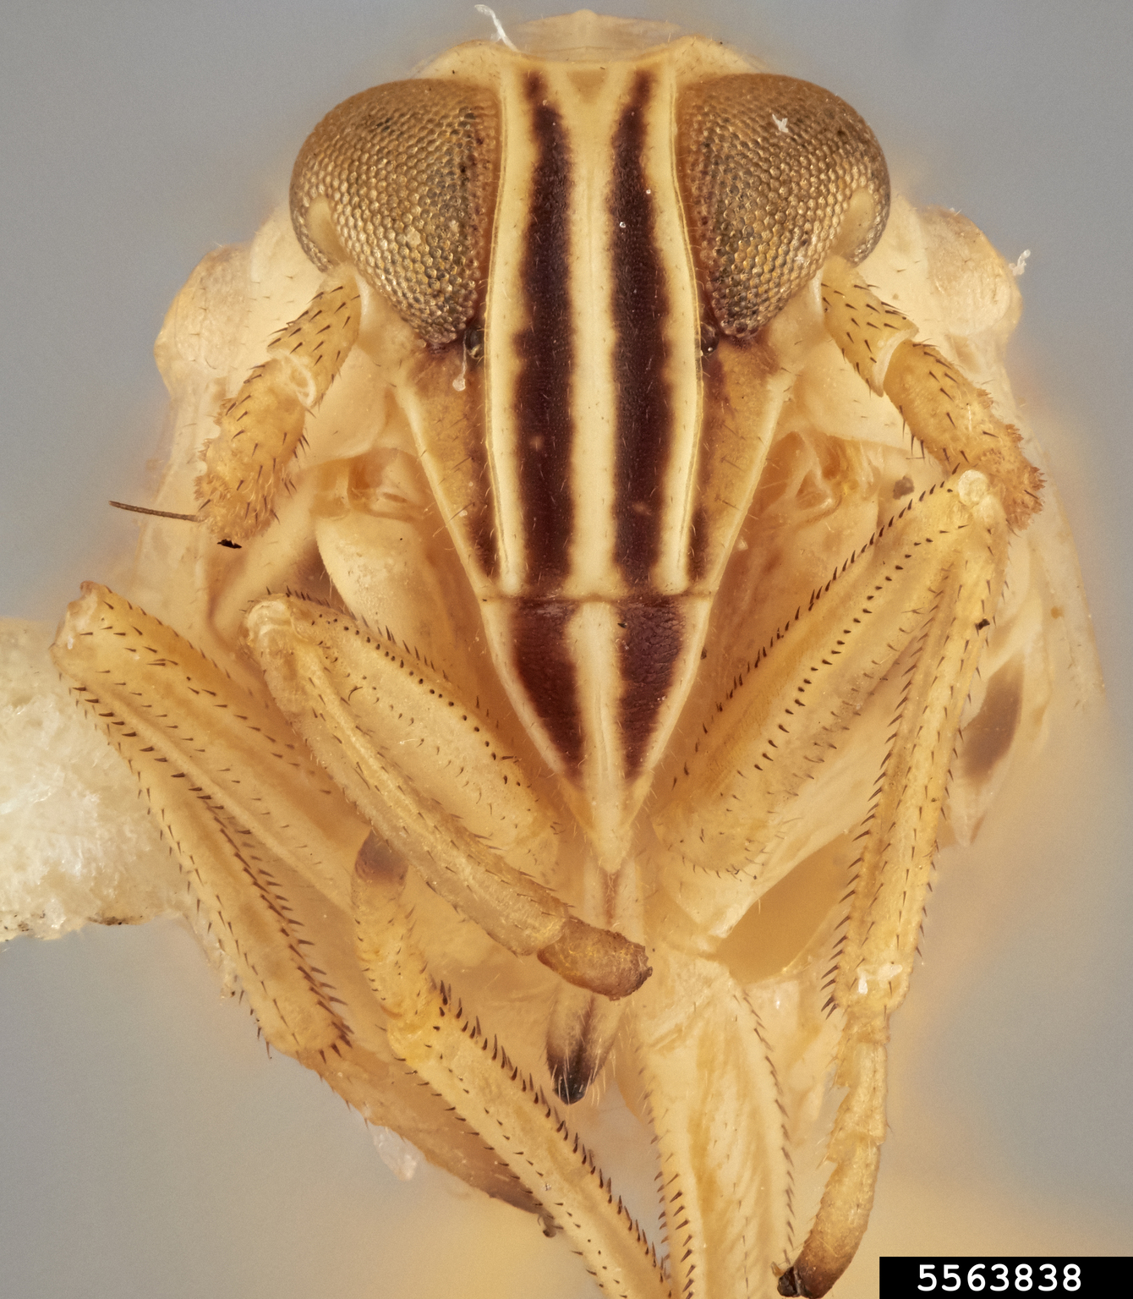
Take Action! with Early Detection
Recognize common invaders and keep an eye out for signs of new ones.
Check often:
Agricultural areas,
Trees,
Gardens and yards,
Vacant lots,
Roadsides,
Wetlands, Ponds, and Lakes.

Slide 13
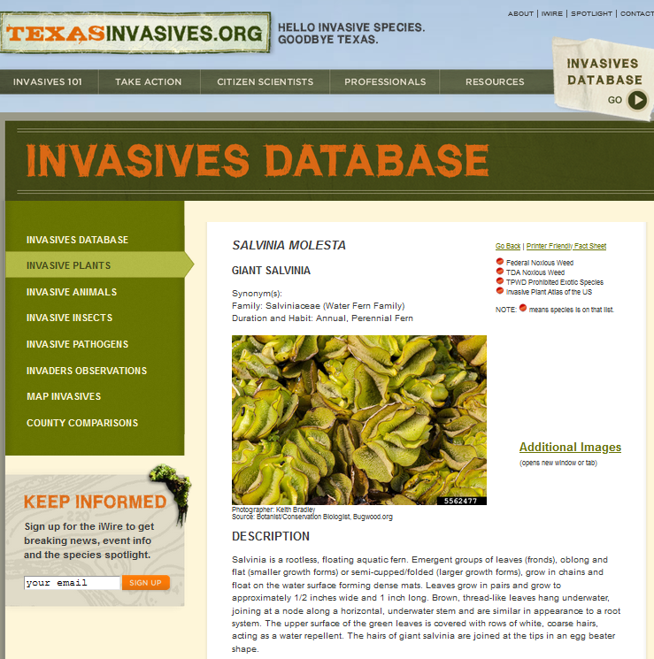
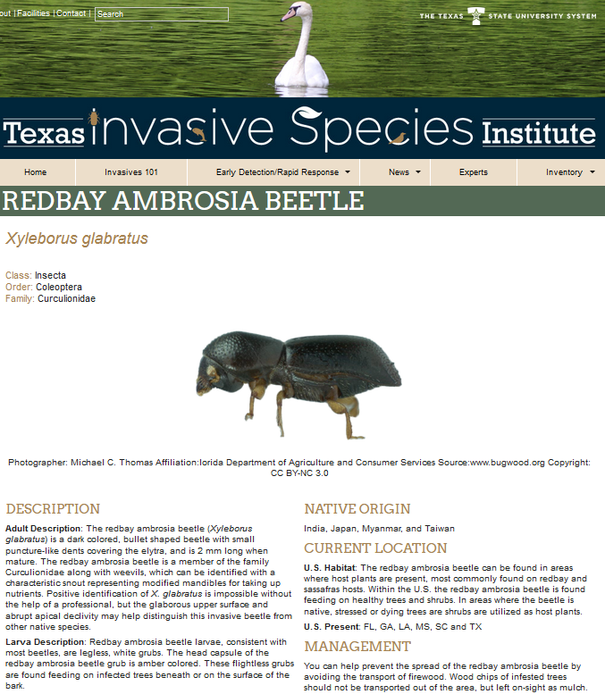
Invasive Species Databases Texasinvasives.org & tsusinvasives.org
Illustrated Descriptions
Distribution & Habitat
Biology & Spread
Introduction History
Ecological Threats
Control & Management
Native Look-a-likes
References
Notes:
Students can ALWAYS look through our websites to see invasive plants, pests, diseases and more!

Slide 14
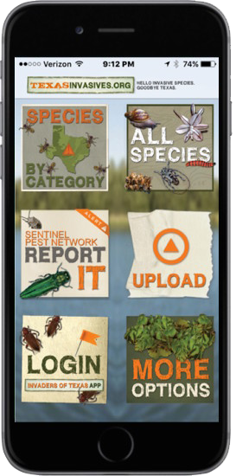
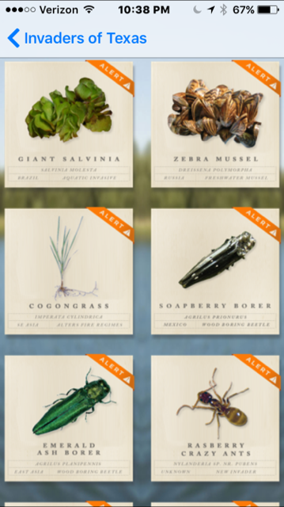
Identification Resources, Continued.
"The Quiet Invasion”
Lower Galveston Bay Watershed and Upper Texas Coast
Digital version: https://www.galvbayinvasives.org/
Produced by HARC
Texasinvasives.org
Mobile app
iOS: Texas Invaders
Android: Texas Invasives

Slide 15

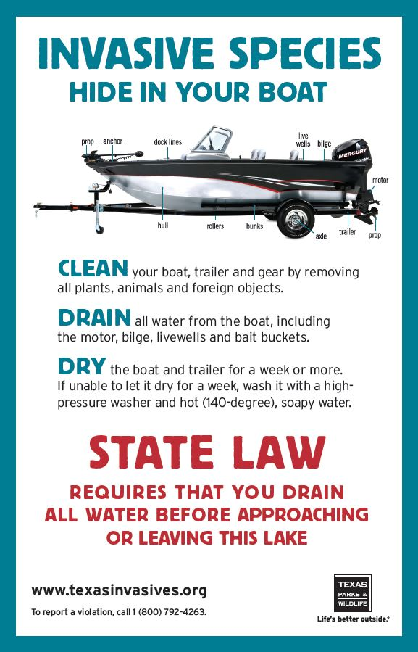
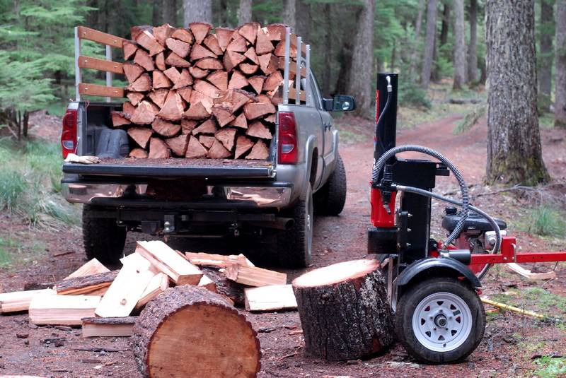

Take Action! by stopping the spread
Two-pronged approach:
Early detection
Prevent transport by humans
Remember difference between terrestrial & aquatic species

Slide 16
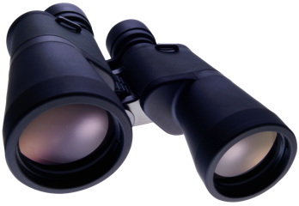

Take Action! with online reporting
Early Detection
Trapping
Monitoring
Vigilance
How you can help!
Notes:
Detection is one way to prevent their spread. \We monitor to try to detect them as soon as possible, so that steps can be take to prevent their spread into an area.
Need to remain vigilant!

Slide 17
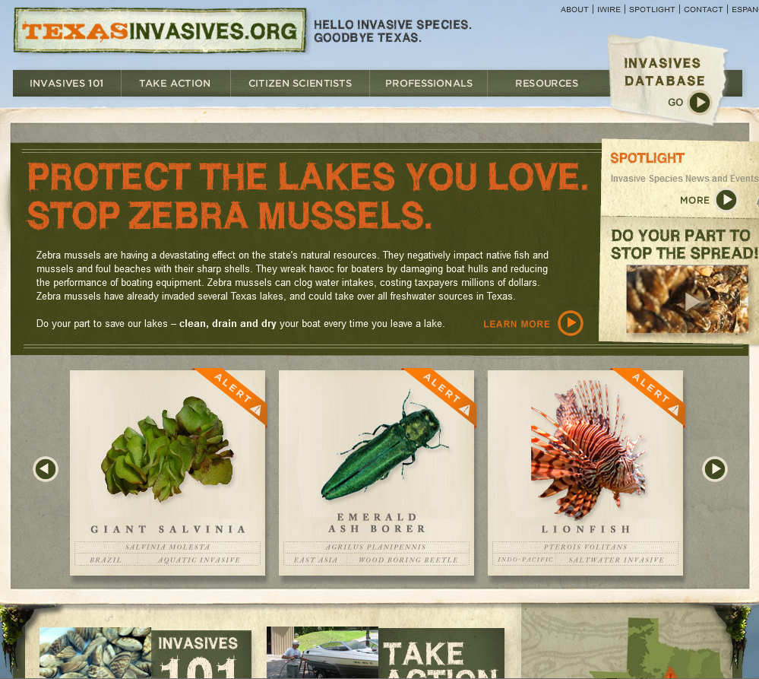
Report It! with Texasinvasives.org
DOES NOT REQUIRE LOGIN!
Notes:
REPORTING ON COMPUTER:
You can scroll through Invasive Species on the homepage to report certain species of great concern in TX.

Slide 18
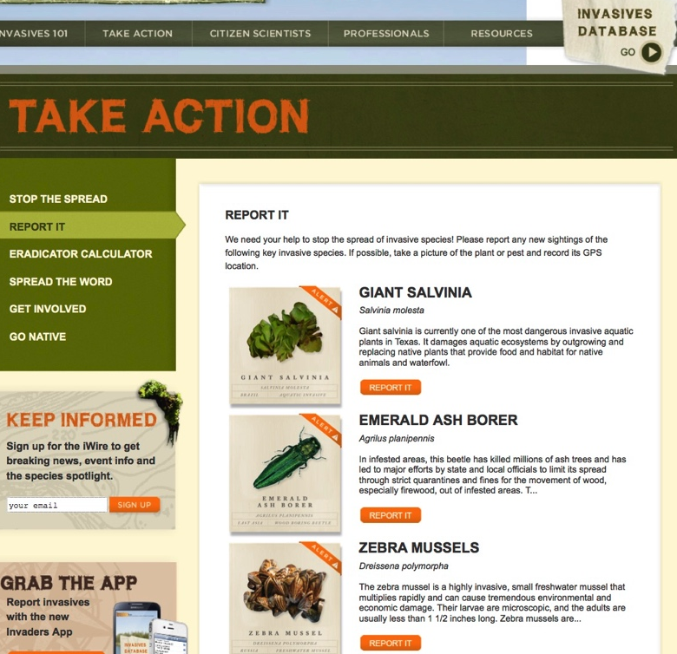
Report It! with Texasinvasives.org
DOES NOT REQUIRE LOGIN!
Notes:
REPORTING ON COMPUTER:
First, upload the photo you're going to use in your report to your computer. Go to texasinvasives.org, click on the TAKE ACTION tab, and then click on the REPORT IT link in the left-hand navigation menu.
Scroll to the species you want to report, click on the image or the "Report It" button, and then complete the form.
The photo file must be no larger than 2 MB in size.

Slide 19
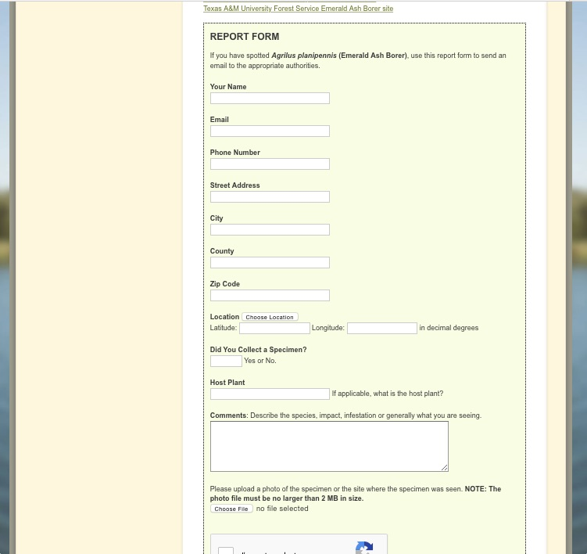

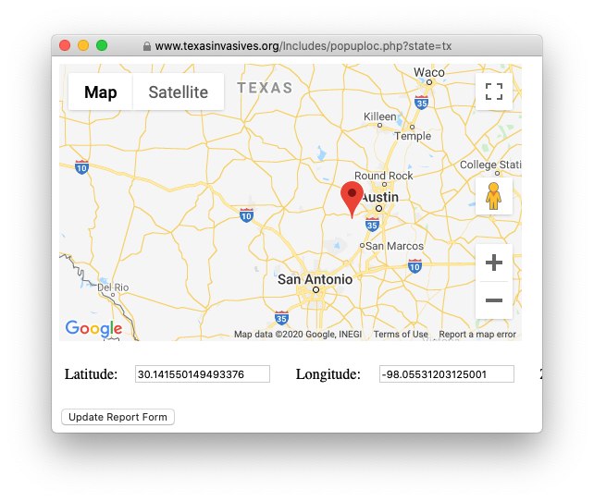
Report It! with Texasinvasives.org
Notes:
A form will pop-up, be sure to include email, location and a photo for validation.

Slide 20
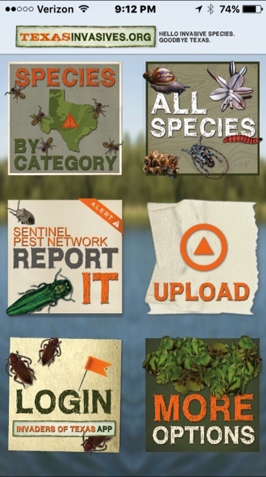
Report It! with the phone app.
Species
Contact info
Location
Photo
Notes
Notes:
REPORTING ON MOBILE APP
Tapping on the species allows the user to submit this information. The report is then sent to experts, who will determine whether further action is needed.
ANYONE can submit a report.

Slide 21
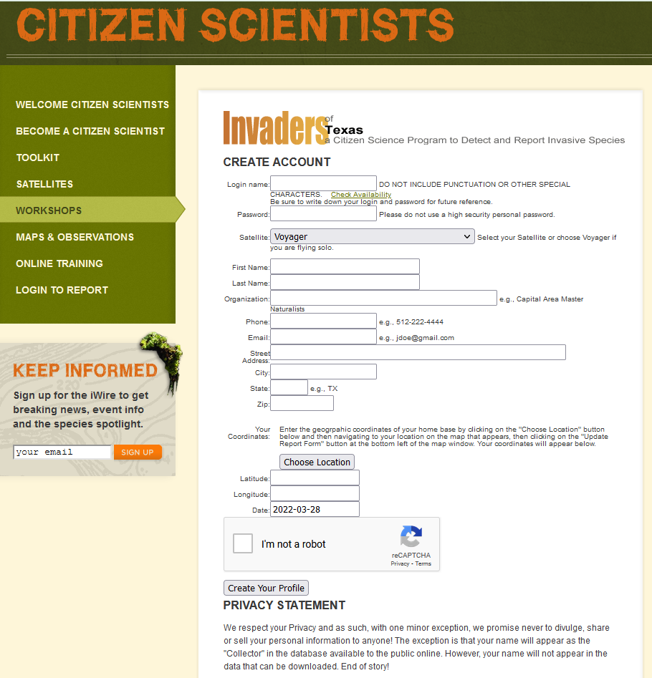
Only if interested (not a grading factor): Go to https://texasinvasives.org/workshop/ to register
Sign-up as Citizen Scientist on Texasinvasives.org
Create Username & Password
Select Voyager for “Satellite”
Notes:
Since your students have gone through a 2-week course about Agricultural Biosecurity and Invasive Species. They are MORE THAN WELCOMED to sign up as a Citizen Scientist with Texasinvasives.org

Slide 22
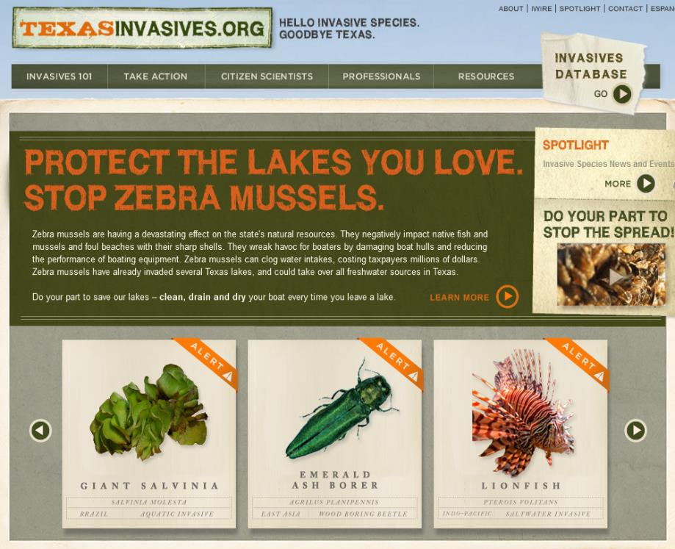
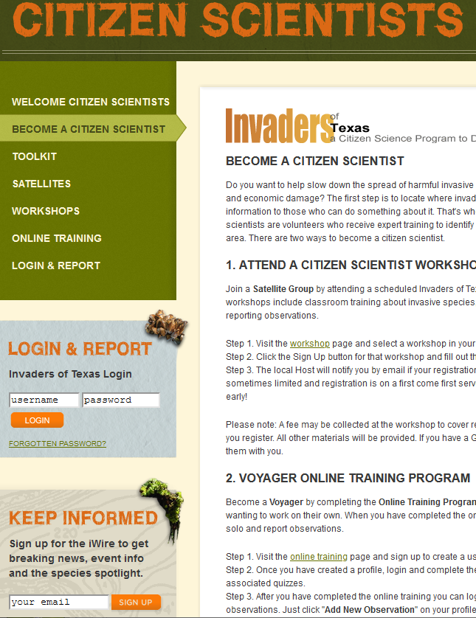
Once Registered, access your Citizen Scientist reporting page.
Citizen Scientist Tab
Then enter Login info
Notes:
Since your students have gone through a 2-week course about Agricultural Biosecurity and Invasive Species. They are MORE THAN WELCOMED to sign up as a Citizen Scientist with Texasinvasives.org

Slide 23
Exit Ticket:
Which pest will have the greatest impact on consumers in Texas and why?

Slide 24


Take Action! Project using the App
Download the phone App
Find more out about these three things.
Blue Hounds Tongue
European Mantis
White Nose Syndrome

Slide 25

Citizen Scientist Presentation to Public
Use this Flowcode to access the “Take Action” page on the Texas Invasives website.
Take a few minutes to look at the Citizens Scientist Program and what all it entails
After you look at the program make a poster that describes what it is and why others should consider to looking into the program.
Notes:
Remember to define an audience in your poster.
Who are you trying to sell this to?
Make the poster look like a billboard in trying to reach out to the audience.

Slide 26



